Slide 1
MOLOCO
Genie Music (지니뮤직)
UA Incrementality Test — Results
Test period: 2026-03-20 → 2026-04-08 | 5% Ghost-Bid Holdout | Android KOR
Prepared by Moloco KOR GDS | April 09, 2026

Slide 2
Test Design
Test Type
Backend Ghost-Bid Incrementality (UPLIFT)
App
com.ktmusic.geniemusic | Android, KOR
Campaign
UA_gpoint (b6VKt5Rtiz6ieomx) — Goal: UA_CPA
Holdout
5% ghost-bid control (no ad shown) | 95% normal test
Duration
2026-03-20 → 2026-04-08 (3 weeks)
KPI Target
≥20% incremental conversion lift
ExpLab ID
UPLIFT-com-ktmusic-geniemusic-JsPxb
Moloco | Confidential

Slide 3
Key Results
Install Lift (CPD_INSTALL)
D7 Action Lift (CPD_DIST_ACT_D7)
D7 Revenue Lift (cROAS_D7)
+91.8%
+150.2%
+260.1%
95% CI: [+82.3%, +102.8%]
95% CI: [+118.9%, +188.6%]
95% CI: [+103.0%, +588.9%]
✅ Meets ≥20% target
✅ Meets ≥20% target
✅ Meets ≥20% target
✅ Moloco demonstrates statistically significant incremental impact (+91.8% install lift), meeting the ≥20% target.
Moloco | Confidential

Slide 4
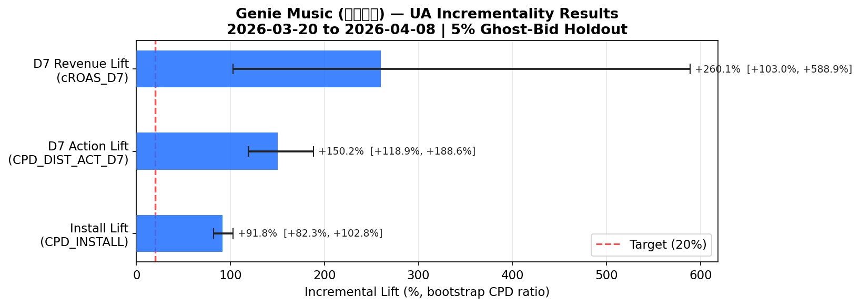
Statistical Confidence — Lift Estimates with 95% CI
Method: Bootstrap CPD ratio (20 bins, 10,000 iterations). CI does not cross 0% → statistically significant at 95%.
Moloco | Confidential

Slide 5
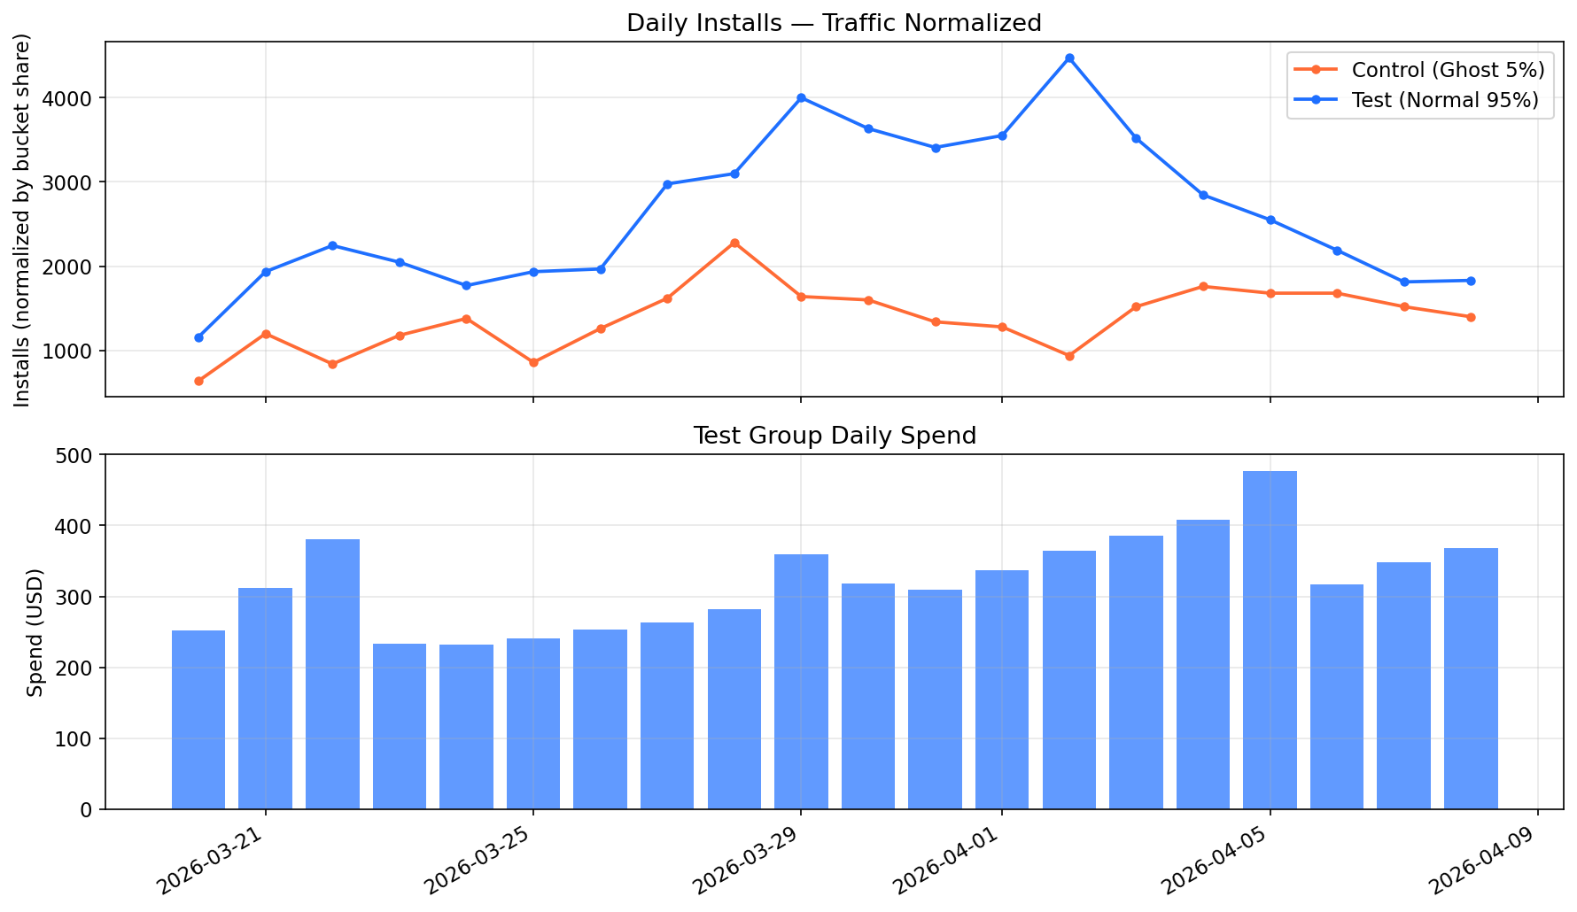
Daily Performance During Test Period
Moloco | Confidential

Slide 6
Conclusion & Recommendations
✅ Moloco UA drives +92% incremental installs (95% CI: [+82%, +103%]) — significantly exceeds the ≥20% target.
📈 D7 post-install actions also up +150% (D7 Revenue +260%), indicating strong quality of incremental users.
💡 Recommendation: Scale UA budget — incremental ROI is proven. Prioritize campaigns targeting install → join_1 funnel.
📅 Next: Share results with Genie Music stakeholders. Consider follow-up ROAS experiment after scaling.
Moloco | Confidential

